Slide 1

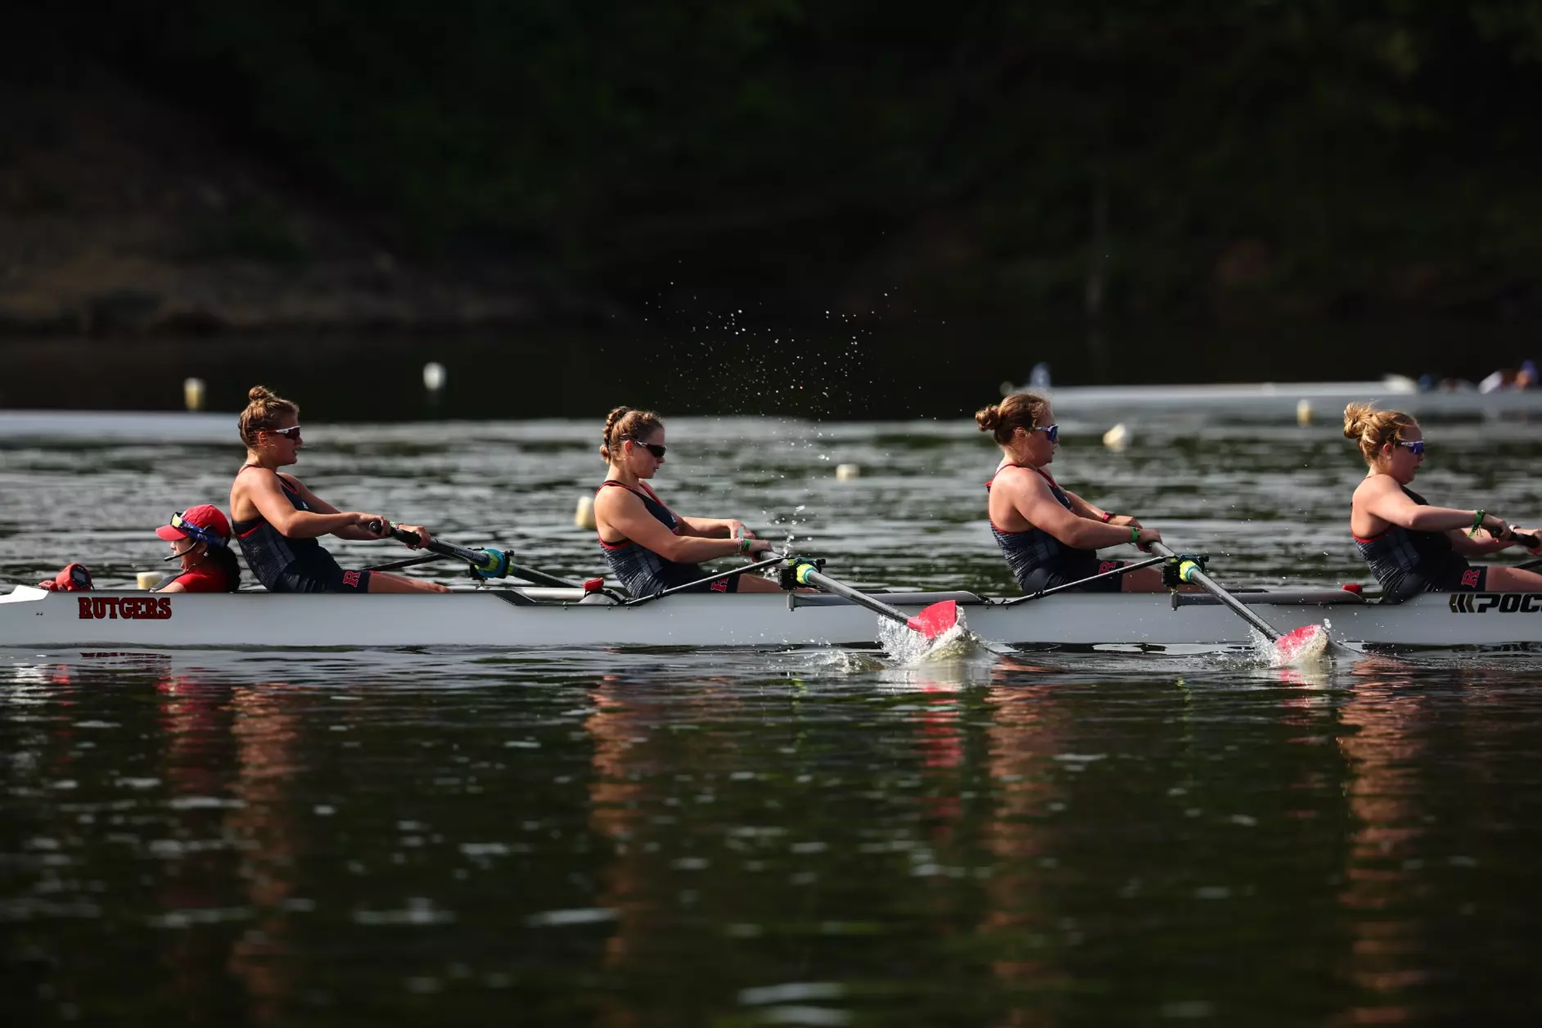
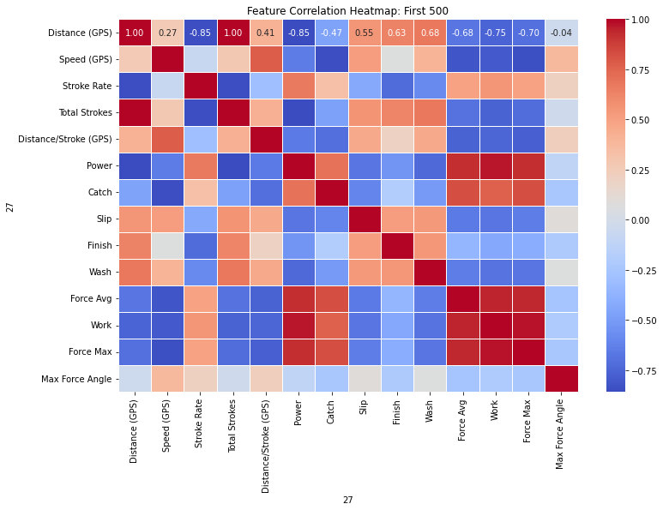
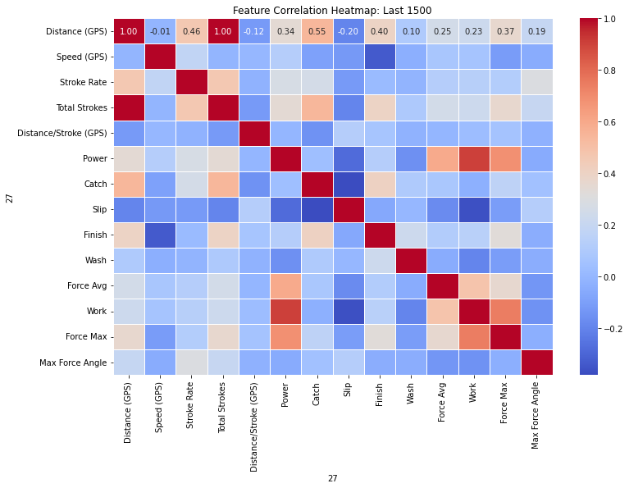
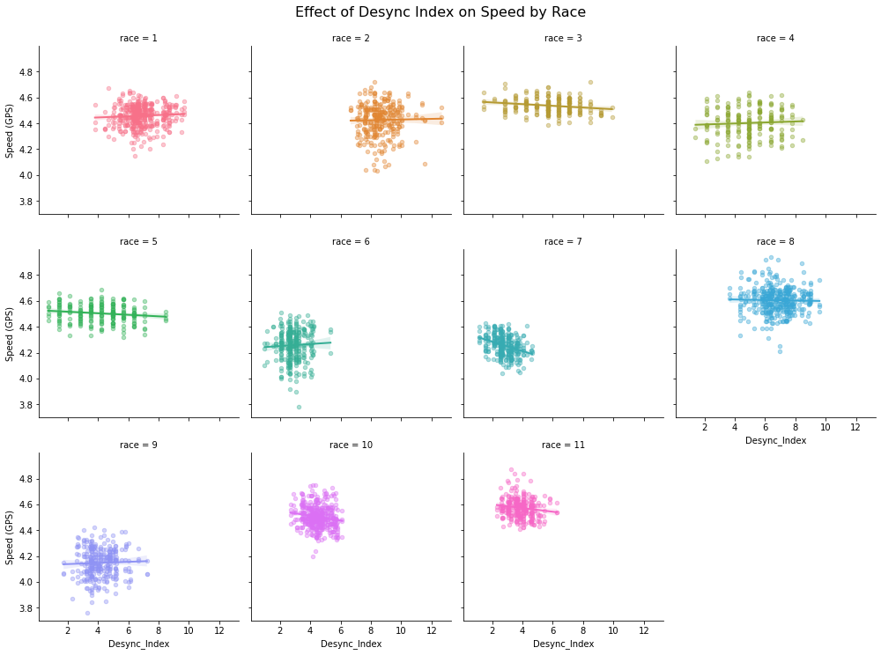
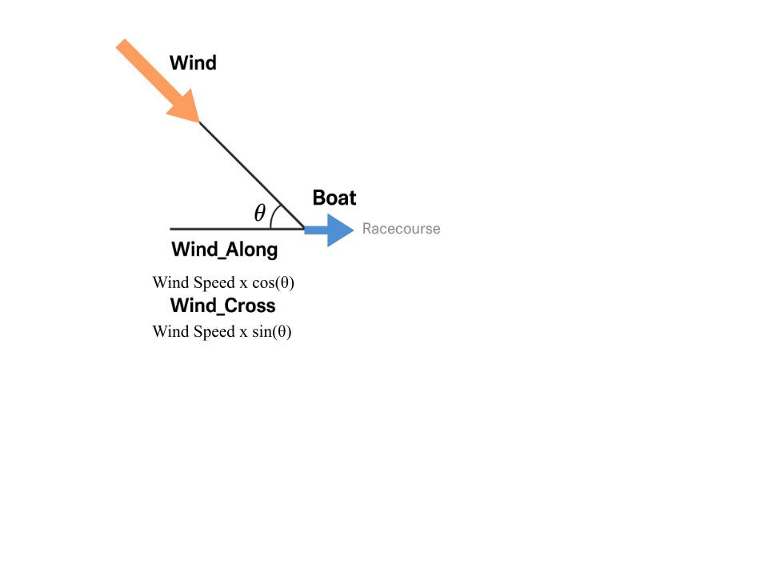

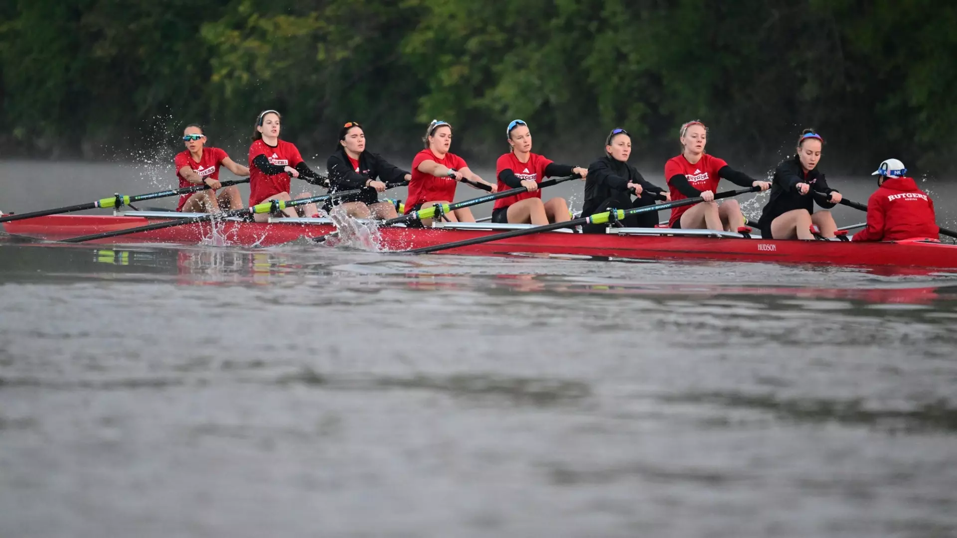
Power, Timing, and Wind: Modeling Performance in Collegiate Rowing Using Sensor Data
Katharina Dowlin
Rutgers Honors College Capstone Project
Introduction
Data Cleaning, Methodology, Preliminary Analysis & Results
Conclusion
Motivation: My experience as a student-athlete on the Rutgers University women’s rowing team.
Goal: Contribute to understanding how rowboat performance can be quantified, analyzed, and ultimately optimized using data.
Research Question: How does alignment between all rowers on one boat affect boat speed and moderate the effect of average power on boat speed?
Filtered to Total Strokes between 100 and 200:
Captures the middle 100 strokes of a 2,000-meter race.
Represents the most stable phase of rowing rhythm and efficiency
Resulting dataset has 3012 rower-stroke observations for 4+ boats in 11 races
Rationale:
Initial analysis showed clear correlation differences between:
The first 500 meters (start): high variability due to race-start intensity.
The final 500 meters (finish): increased variability from fatigue and sprint effort.
The middle section provides cleaner, more consistent data for evaluating effect of technical alignment on boat performance.
Data Cleaning Procedures:
Removed duplicate strokes (errors in recording) based on Total Strokes to retain unique stroke entries per rower per race.
Dropped NaN values to ensure data integrity.
Applied numeric conversions for all key sensor-derived variables (e.g., Power, Catch, Finish, etc.).
Feature Engineering:
Average Power per Stroke: Average power of all rowers on boat for each stroke (Watts)
Power Misalignment: SD(Power of each stoke for all rowers (Watts))
Catch Misalignment: SD(Effective Catch Angle) =SD(Catch + Slip)
Finish Misalignment: SD(Effective Finish Angle) = SD(Finish - Wash)
Effective Length = |(Catch + Slip) − (Finish − Wash)|
Desync Index = Effective Catch SD + Effective Finish SD
Power Misalignment Interactions: Standardized interaction terms between average power per stroke and misalignment in power, effective catch, and effective finish
Random Forest Model Results: Feature Importance for predicting Boat Speed (Meters/Sec for each stroke from GPS)
Goal: Identify which variables most strongly predict Speed using a non-parametric ensemble model.
Top Predictor: Wind Along the course direction
Importance score: 0.52
Indicates that tailwinds or headwinds had largest impact on speed, confirming external conditions as a major performance factor.
Secondary Predictor: Wind Cross (perpendicular to the course)
Importance score: 0.18
Also influential, though less than head/tail wind (may affect steering and balance).
Led to the use of mixed-effects models to control for wind variability across races by using race as the random effect in the model to better isolate rower technical contribution.
Results - Mixed-Effects Models (All Boats):
Speed ~ Stroke Rate + Effective Length + Max Force Angle + Misalignment Terms + Avg Power per Stroke + Interaction Terms
Effective Length: Negative, significant
→ Suggests longer strokes aren't always better, possibly due to poor connection at extremes of stroke length.
Max Force Angle: Negative, significant
→ More centered peak force appears more effective for speed.
Avg Power per Stroke: Positive, significant
→ More power still matters, but within context of how it's applied.
SD of Effective Finish: Negative, significant
→ Misalignment at the finish reduces speed.
Power-Fit Interaction (Power): Negative, significant
→ Benefit of average power on speed depends on the consistency of that power across rowers.
Results - Mixed-Effects Models (Boats with data from all 4 rowers):
Key Differences:
Stroke Rate: Now significant
→ In fully crewed boats, higher rate correlates better with speed.
Power-Fit Interaction: ~Moderate effect
→ Borderline significance for Power x Catch SD suggests coordination might enhance the impact of power.
Other variables generally directionally consistent with first model.
Wind:
Wind Along the Course was the most important predictor of boat speed in the Random Forest model (52% of feature importance).
Crosswinds had a smaller but noticeable effect; wind variables were controlled using race-level random effects in mixed models.
Variability:
Rowing speed decreased as within-boat stroke variability increased.
This effect was stronger in races where all four rowers had data.
Power:
Average Power per Stroke had a positive relationship with speed.
But its interaction with Power Misalignment was negative and significant:
The effect of average power on boat speed is larger when power applied by each individual rower is similar.
Misaligned power output (high SD) reduced the effectiveness of average power.
Effective Catch & Finish SD:
Variability in Catch and Finish mechanics (especially SD of “Effective Catch”) was correlated with performance.
Including these variability metrics improved model fit.
· Me in the Varsity 4+ that placed 10th at the 2024 NCAA Championships.
Data
Future Work
Rowing data
Collected by the Empower Oarlock system in Rutgers rowboats during regattas in the spring 2024 season.
Empower Oarlock sensors provide high-frequency stroke-level data for each rower including power output, stroke length, force curves, catch, and finish angles.
Historical wind data
Accounts for environmental conditions, which prior research has shown to be the main determinant of boat speed.
Wind speed and wind direction at the time of each race obtained from wunderground.com
Steps taken to quantify effect of wind on boat performance
Determined heading angle of each racecourse (the direction in which the boat was traveling) using the start and finish GPS coordinates.
Calculated the angle difference between wind direction and boat’s heading.
Created two derived variables: wind along the course (Wind_Along) and wind across the course (Wind_Cross).
Using this angle difference (θ), the wind vector was decomposed into components:
Future Research:
Expand to full boats (8+ coxswain) and test whether the same alignment metrics scale up in complexity.
Investigate the how the desynchronization of a boat can affect boat speed.
Apply unsupervised clustering or PCA to discover hidden patterns in rowing styles or rhythm.
Investigate fatigue effects over race duration by analyzing early, mid, and late race segments separately.

